Slide 1
Assessing the impact of COVID-19 on Liver Cancer

Slide 2
ABSTRACT
The rise in primary liver cancers, notably hepatocellular carcinoma (HCC) due to alcohol-related liver disease and non-alcoholic fatty liver disease, has been a concerning trend in Northern England. The emergence of the COVID-19 pandemic further exacerbated challenges within healthcare systems, particularly affecting liver cancer patients. This study aims to assess the impact of the pandemic on survival rates among newly diagnosed liver cancer patients in the region. Utilizing survival analysis techniques, we compared data from before and during the pandemic to identify key factors influencing patient prognosis. Our findings shed light on the dynamic interplay between the pandemic and liver cancer outcomes, providing valuable insights for developing effective clinical strategies and patient management approaches amidst the COVID-19 era. By understanding these impacts, healthcare professionals can better tailor care for liver cancer patients and navigate the complexities of managing this disease in the context of a global health crisis.

Slide 3
INTRODUCTION
Since the onset of the COVID-19 pandemic, the global healthcare system has faced unprecedented challenges, with over 290 million confirmed infections and 5 million deaths reported worldwide.
Healthcare resources have been strained, leading to cancellations or delays in essential activities such as chronic disease management, cancer screening, and treatments, potentially resulting in increased cancer-related deaths.
The impact of COVID-19 on patients with primary liver cancer (PLC) remains under investigation, with European data suggesting disruptions to hepatocellular carcinoma (HCC) services and a reduction in incident cases during the pandemic's first wave.
In Northern England, the incidence of PLC has been on the rise, driven by factors such as obesity-associated non-alcoholic fatty liver disease (NAFLD) and alcohol-related liver disease (ARLD).
The region experienced sustained effects during the second wave of the pandemic, prompting an evaluation of COVID-19's impact during its first year (including the first and second waves until February 2021) to derive key insights and recommendations for future service provision.

Slide 4
2. METHODOLOGY AT A GLANCE
The methodology of the study consists of three main stages:
Data Preparation: This stage involves comparing various imputation approaches to address missing data and selecting the most suitable method.
Exploratory Analysis and Hypothesis Testing: Here, we conduct exploratory data analysis to gain insights into the dataset and perform several hypothesis tests such as chi-squared tests, t-tests, proportions-test to examine relationships between variables.
Survival Analysis: In this stage, we utilize survival analysis techniques to analyze the impact of different factors on survival outcomes among liver cancer patients. Specifically, we utilize Kaplan-Meier curves to visualize survival probabilities over time for different patient groups or characteristics. We also apply Cox proportional hazards model to assess the impact of various factors on survival outcomes, adjusting for potential confounders.

Slide 5
2.1 DATASET OVERVIEW
For the purpose of this study the dataset titled ‘COVID-19 effect on Liver Cancer Prediction Dataset’ is sourced from Kaggle.
It includes information gathered from patients seen by the Newcastle-upon-Tyne NHS Foundation Trust (NUTH) hepatopancreatobiliary multidisciplinary team (HPB MDT),situated in Northern England, during the first year of the COVID-19 pandemic (March 2020- February 2021) and is compared with data from the year before (March 2019 - February 2020).
The dataset focuses on patients diagnosed with liver cancer, specifically hepatocellular carcinoma (HCC) or intrahepatic cholangiocarcinoma (ICC). The main objective of the dataset is to assess the impact of the COVID-19 pandemic on patients with newly diagnosed liver cancer.
The dataset comprises 450 entries and encompasses 27 distinct attributes.

Slide 6
KEY DATASET ATTRIBUTES
Attribute | Description
Cancer | Flag indicating presence of cancer (Yes/No)
Year | Year of Liver Cancer diagnosis (pre-pandemic/pandemic)
Month | Month of year (1-12)
Mode Presentation | Manner in which cancer was detected - Surveillance, Incidental, or Symptomatic
Age | Patient’s Age at diagnosis
Gender | Male/Female
Etiology | Cause of liver disease
Size | Diameter of tumor in millimeters
Cirrhosis | Flag indicating presence of underlying liver disease (Yes/No)

Slide 7
Attribute | Description
HCC BCLC Stage | Staging of Hepatocellular carcinoma (I, II, IIIA+IIIB, IV)
HCC_TNM_Stage | Staging of Hepatocellular carcinoma (I, II, IIIA+IIIB, IV)
Treatment_grps | First-line treatment received - options include "OLTx" (orthotopic liver transplantation), "Resection", "Ablation", "TACE" (transarterial chemoembolization), "SIRT" (selective internal radiation therapy), "Medical", or "Supportive care"
Survival_fromMDM | Survival following Metachronous Distant Metastasis
Alive_Dead | Patient's survival status (Alive/Dead)
Surveillance_programme | Whether patient is enrolled in a formal surveillance program (Yes/No)
PS | Performance status of the patient (0-4)
Prev_known_cirrhosis | Indicates if cirrhosis was known prior to diagnosis (Yes/No)
These are the primary features used in the analysis after data cleaning.

Slide 8
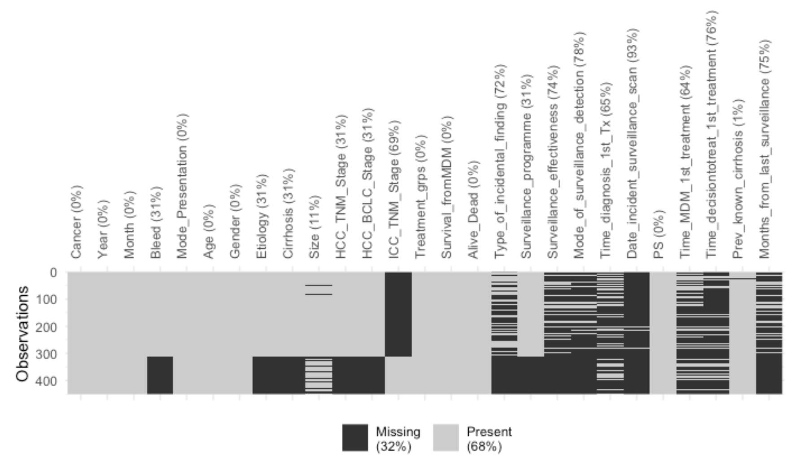
VISUALISING MISSING VALUES
We began our analysis by examining the proportion of missing data within the original dataframe.
A substantial portion of the variables exhibit missing values exceeding 35%.
Consequently, we opt to omit these attributes from our analysis, as their integrity may be compromised due to the high rate of missing data.

Slide 9
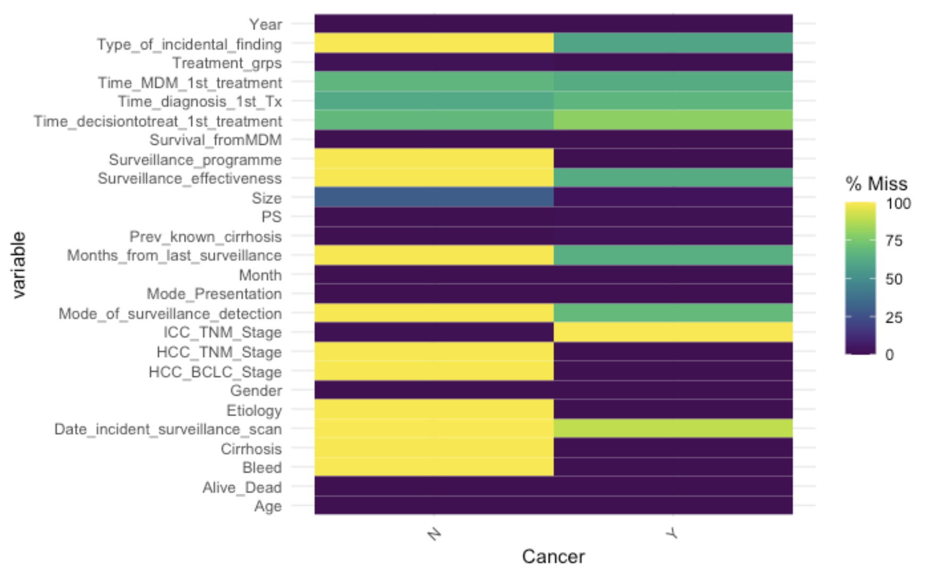
To achieve our analytical goals, the first step is to identify the types of missing values present in the dataset i.e. to determine whether the missing values in our dataset follow a pattern of being missing completely at random (MCAR), missing at random (MAR), or missing not at random (MNAR).
We plotted the number of missing values for each variable, broken down by a factor using gg_miss_fct(df, Cancer)
The noticeable disparity in missing data counts between 'Cancer N' and 'Cancer Y' levels suggests that the missingness might not adhere to the Missing Completely At Random (MCAR) assumption.

Slide 10
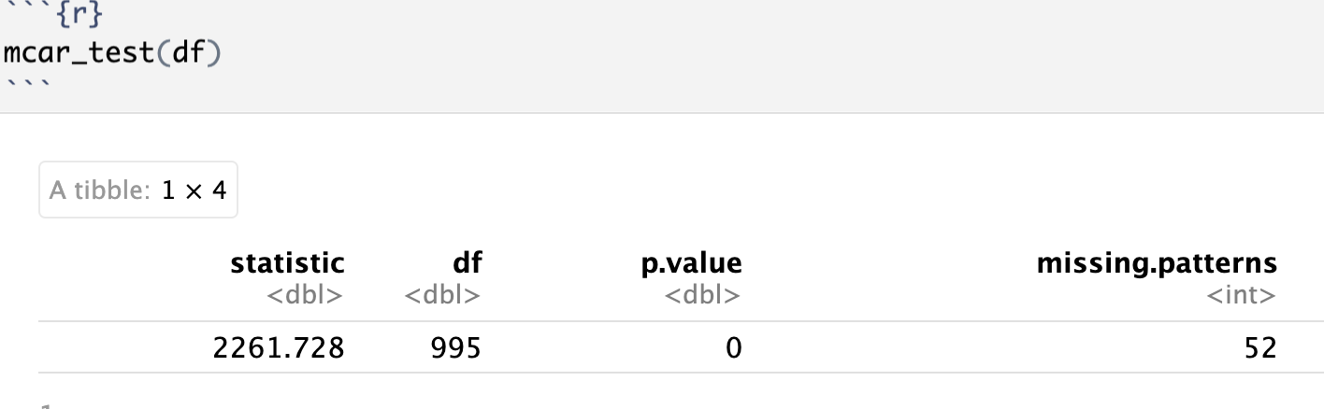
Next, we conducted Little's MCAR test, which involves hypothesis testing to evaluate the randomness of missing values in our dataset. Specifically, this statistical test assesses whether the missingness of data is independent of both observed and unobserved variables, thus indicating MCAR.
Null Hypothesis (H0): The data is MCAR.
Alternative Hypothesis (Ha): The data is not MCAR.
The test yielded a p-value of 0, leading to the rejection of the null hypothesis. Therefore, we infer that the data do not follow the Missing Completely At Random (MCAR) pattern.

Slide 11
2.3 PROCEDURE FOR COMPARISON OF DIFFERENT MULTIPLE IMPUTATION METHODS
Prior to commencing the imputation process, we systematically utilized all complete rows and introduced missing values with a probability of 0.3 under the assumption of missing at random (MAR). Subsequently, we applied three distinct multiple imputation methodologies: Predictive Mean Matching, Random Forest imputation, and MissForest imputation to handle the remaining missing values.
For each imputation technique, we generated five sets of imputed values across ten iterations to ensure robustness. Following this, we conducted a comprehensive evaluation of each imputation method's performance by fitting a linear model on the newly imputed datasets. We employed 10-fold cross-validation and used "Size" as the outcome variable. This enabled us to derive key metrics such as Root Mean Squared Error (RMSE) and Mean Absolute Error (MAE) to assess the efficacy of each approach.

Slide 12
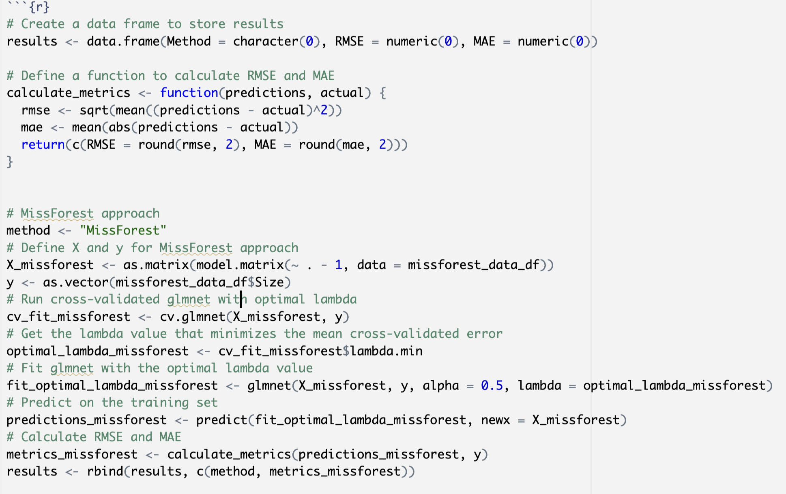
CODE SNAPSHOT
<- Tumor Size is used as the response variable

Slide 13
2.4 Survival Analysis
Kaplan-Meier survival curves were generated to visualize the estimated survival probabilities over time for different categorical variables. The "ggsurvplot" function from the "survminer" package was utilized to create graphical representations of the survival curves.
The log-rank test was employed to assess the significance of differences in survival curves between groups. This test evaluates whether there are statistically significant differences in survival distributions across groups by comparing observed and expected survival times.
Results from Kaplan-Meier survival analysis and log-rank tests were interpreted to understand the impact of variables on survival outcomes in liver cancer patients, focusing on differences in survival probabilities between groups and their significance.
A Cox proportional hazards model was employed to analyze significant variables influencing survival outcomes. The C-index was reported to assess the predictive accuracy of the model

Slide 14
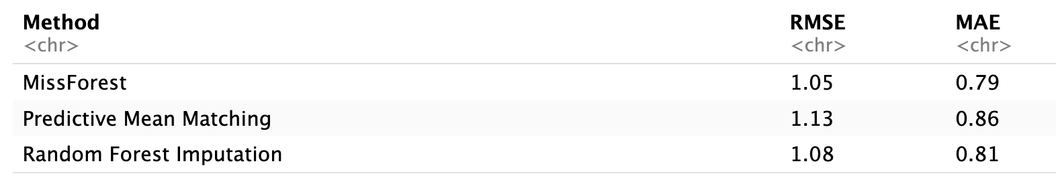
3. RESULTS
3.1 Comparison of Imputation approaches:
Following rigorous evaluation, we meticulously selected the imputation method exhibiting the lowest RMSE and MAE values and utilized this chosen technique to fill in missing values in the original dataset, thereby ensuring the integrity and reliability of our dataset for further analysis.
The results of the imputation :
Given that MissForest imputation demonstrated the lowest RMSE and MAE among the methods evaluated, we opted to utilize it to impute missing values across our entire dataset.

Slide 15
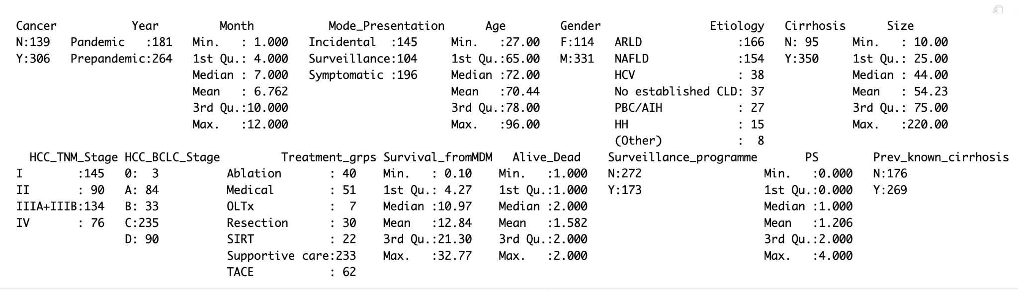
3.2 EXPLORATORY DATA ANALYSIS
The majority of patients presented symptomatically.
Age ranged widely, from 27 to 96 years.
Most patients had underlying liver disease (Cirrhosis).
The largest tumor size observed was 220 mm.
The predominant stages were HCC_TNM_Stage 1 and HCC_BCLC_Stage 'C'.
The majority of patients were categorized under the Supportive Care treatment group.
Patients were predominantly at high risk of mortality.
Most patients were not part of a surveillance program.

Slide 16
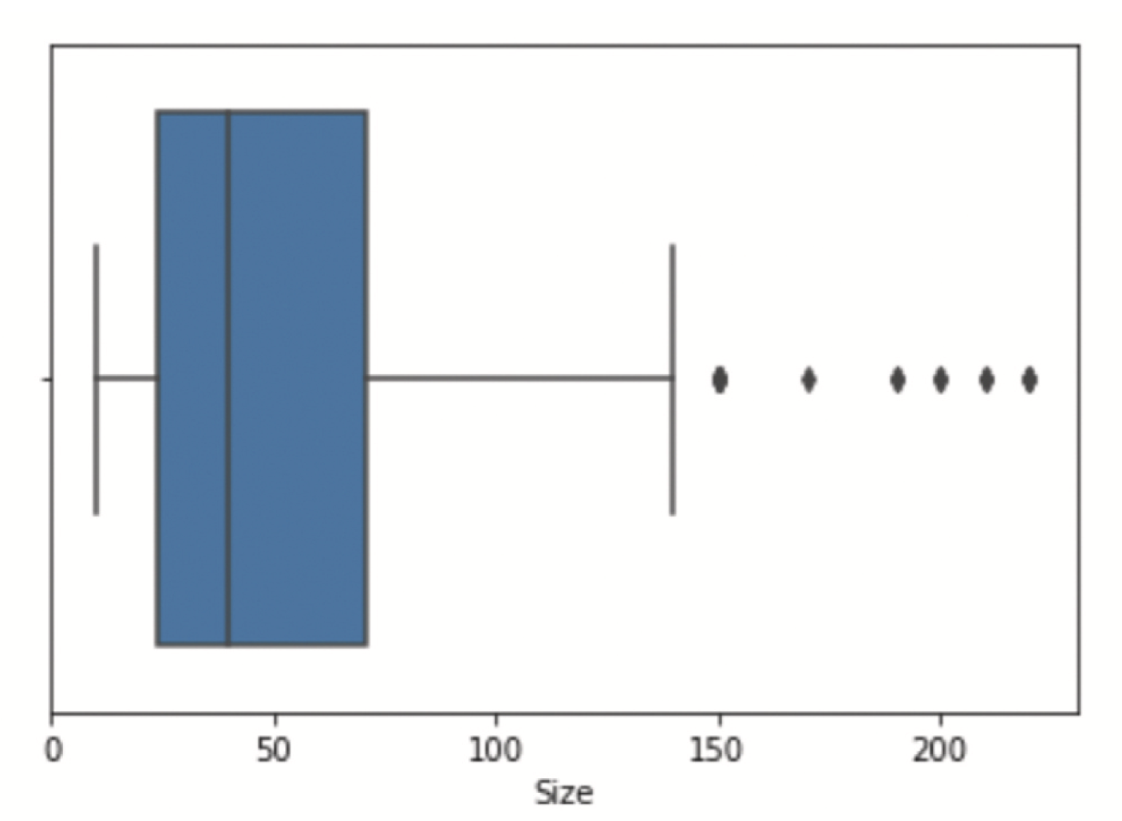
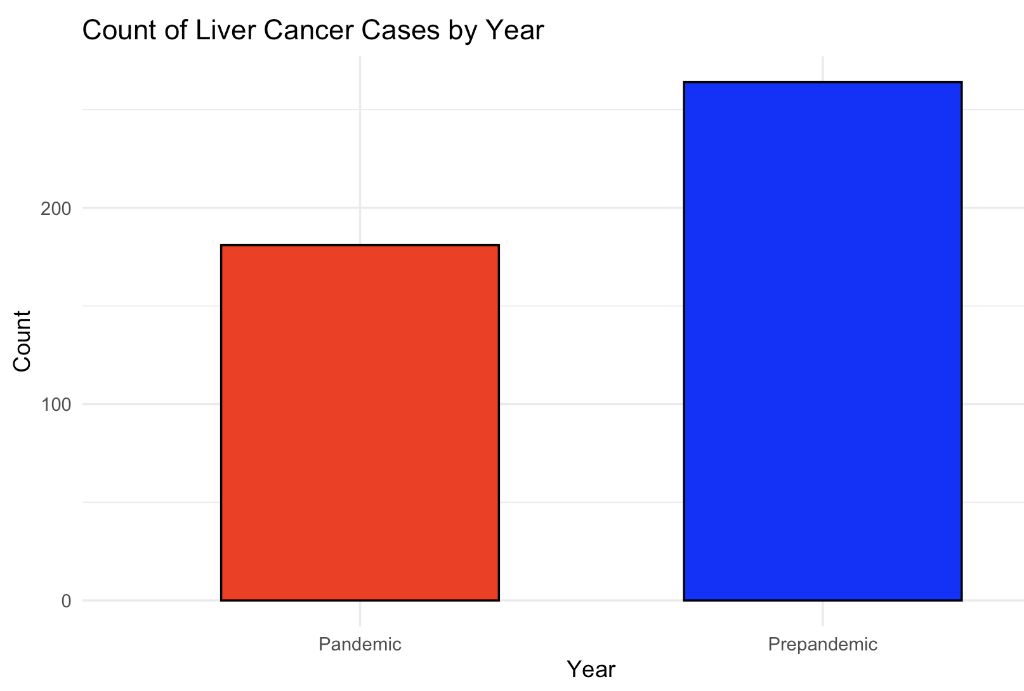
Boxplot of Tumor Size
While most tumor sizes fall within the interquartile range, a few outliers indicate the presence of exceptionally large tumors.
These outliers, although unusual, may represent medically relevant cases, and thus, we refrain from removing them to preserve valuable information.
Despite their outlier status, these entries are retained in the analysis due to their potential clinical significance.
The count plot demonstrates a decrease in the number of cancer cases detected during the pandemic, showing an approximate 30% decline compared to non-pandemic periods.

Slide 17
3.3 HYPOTHESIS TESTING

Slide 18
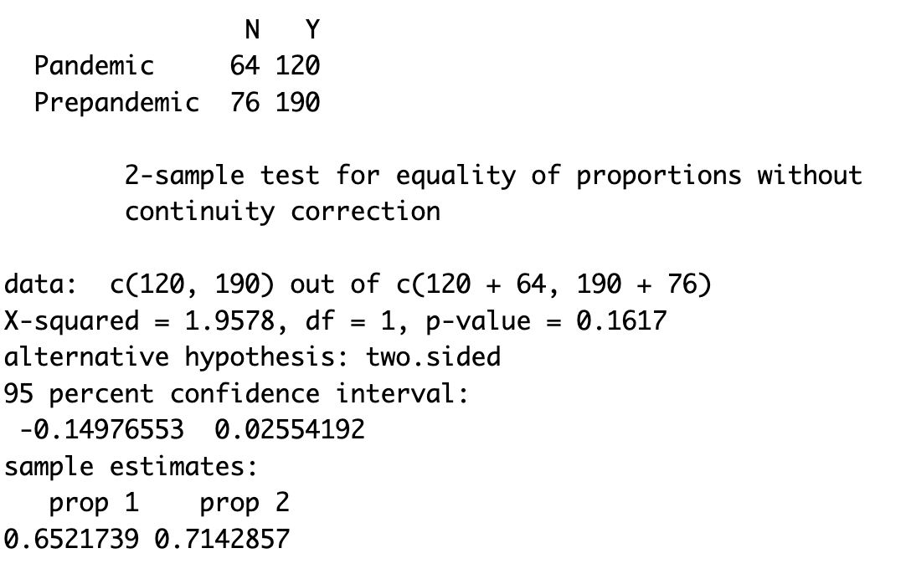
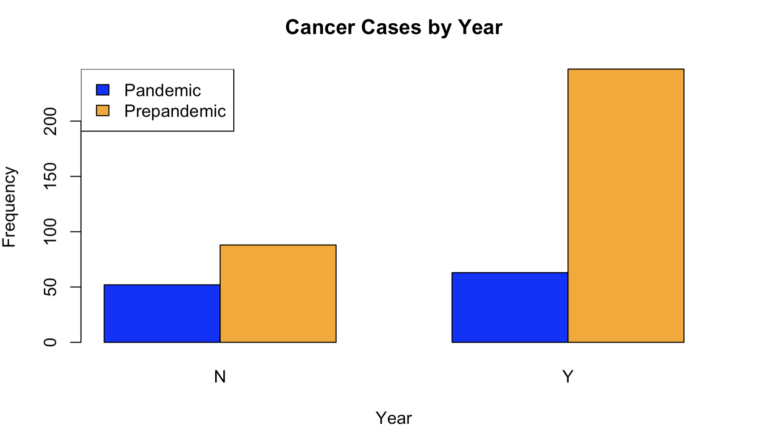
Did the proportion of cancer cases differ significantly between the pandemic and pre-pandemic periods?
Null Hypothesis (H0): The number of cancer cases during the pandemic is equal to the number of cancer cases during the pre-pandemic period.
Alternative Hypothesis (Ha): The number of cancer cases during the pandemic is not equal to the number of cancer cases during the pre-pandemic period.
The analysis conducted was a two-sample test for equality of proportions without continuity correction.
The obtained p-value of 0.16 suggests that there's no significant difference in proportions between the pandemic and pre-pandemic periods. Therefore, it seems the COVID-19 pandemic didn't notably impact the proportion of cancer cases observed.

Slide 19
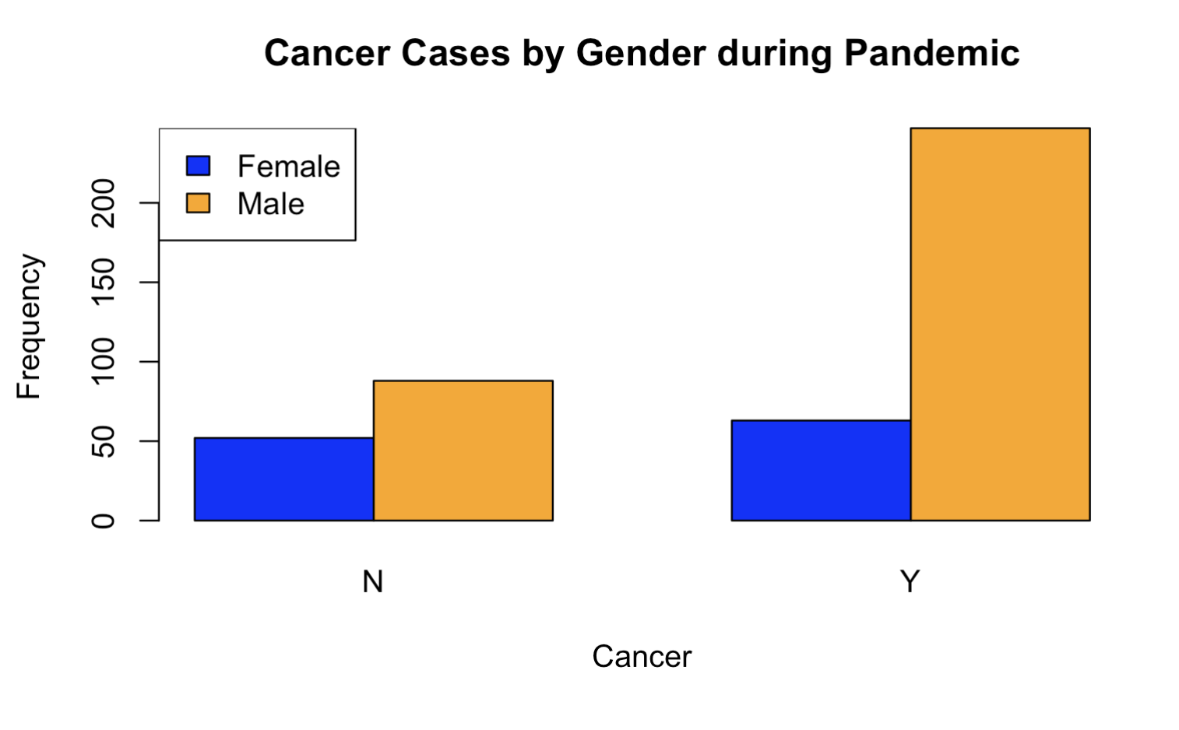
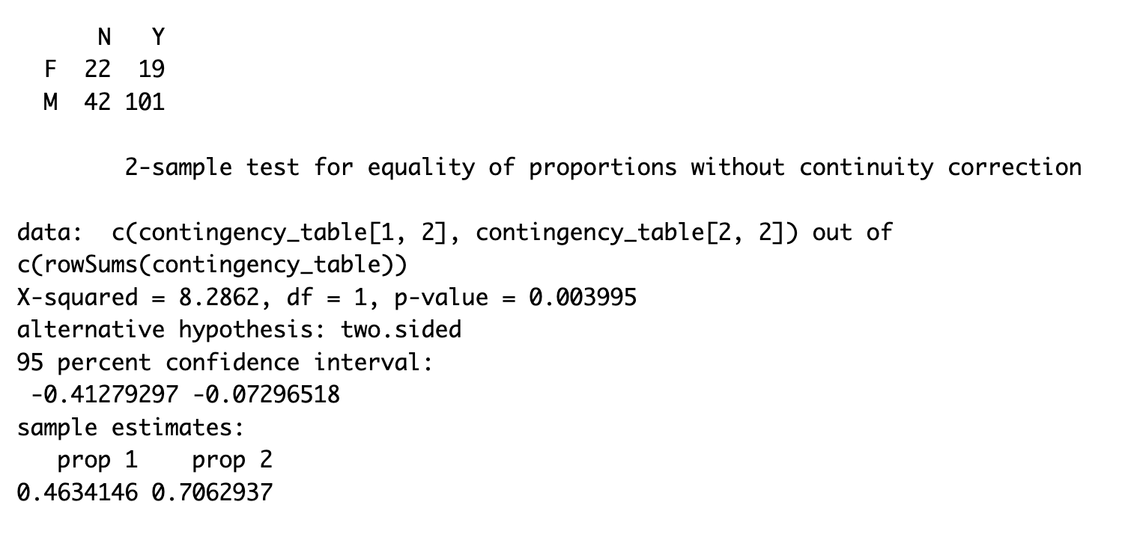
Did COVID-19 Impact Cancer Case Proportions Across Genders?
Null Hypothesis (H0): The proportion of cancer cases between genders during the pandemic is equal.
Alternative Hypothesis (Ha): The proportion of cancer cases between genders during the pandemic is not equal.
We conducted a two-sample test for equality of proportions without continuity correction to compare the proportion of cancer cases between genders during the pandemic period.
With a p-value of 0.003995 (< 0.05), we reject the null hypothesis, indicating a significant difference in cancer case proportions between genders during the pandemic. Particularly, males show a notably higher proportion of cancer cases compared to females.

Slide 20
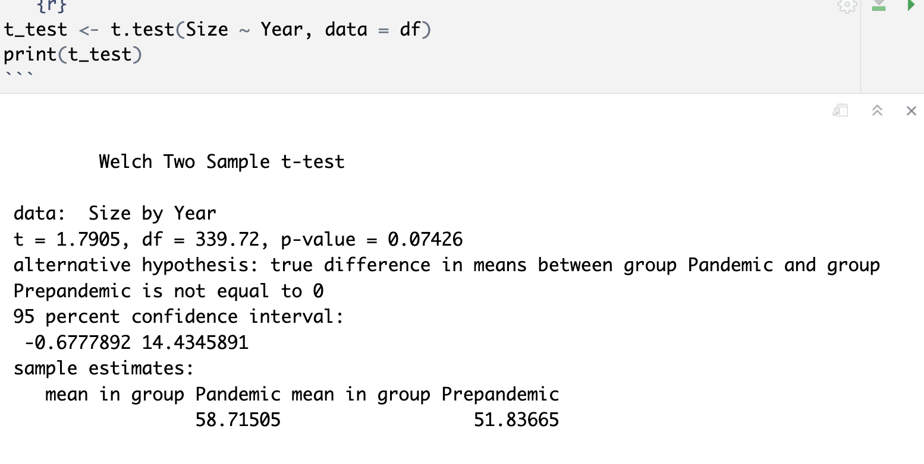
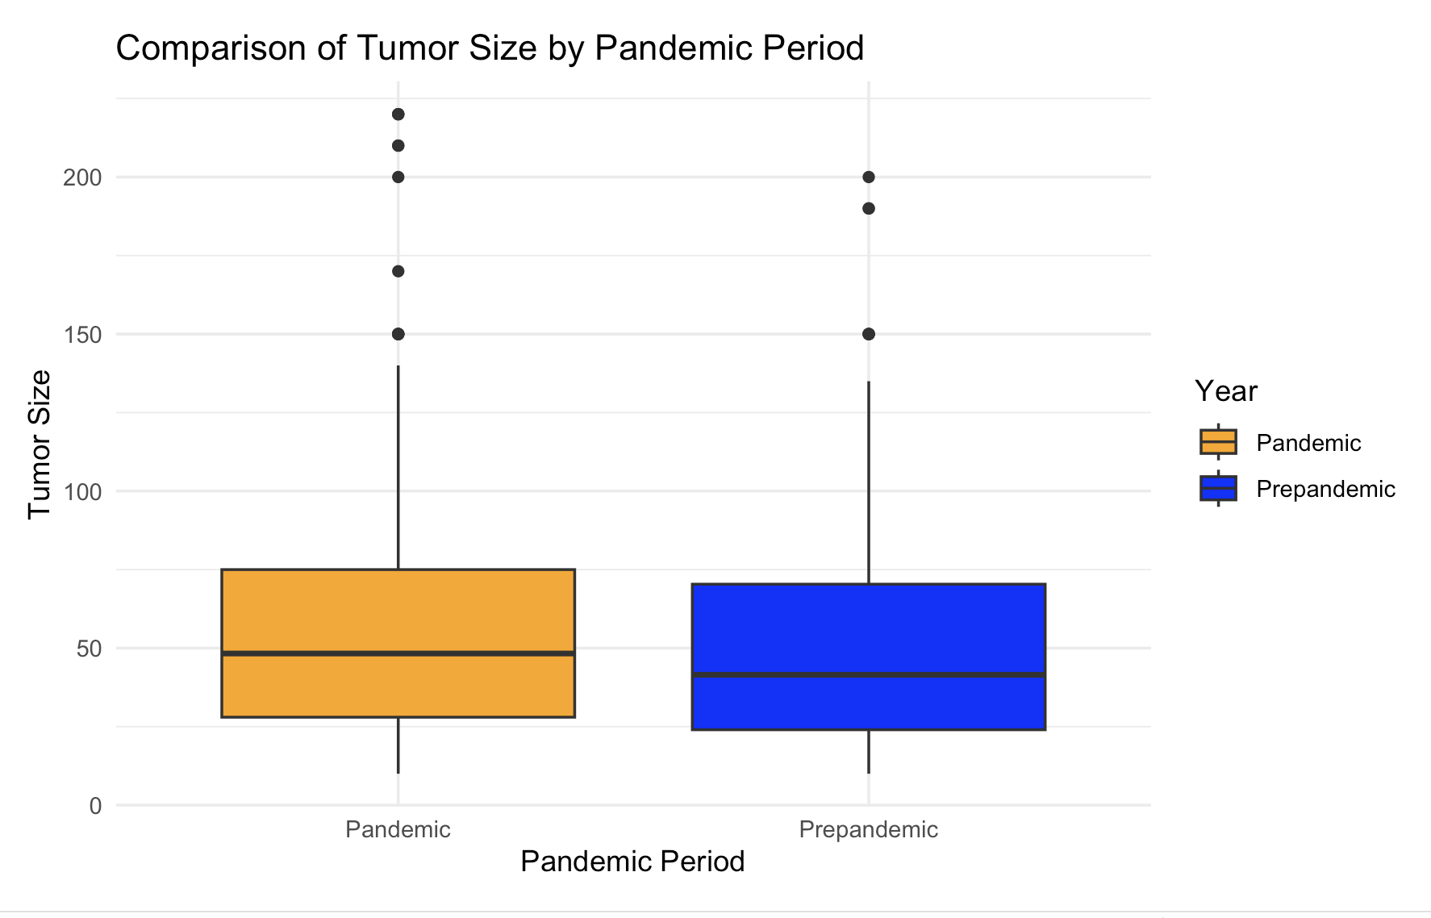
Did COVID-19 Influence Tumor Size in Comparison to the Pre-Pandemic Period?
The box plot shows that the average tumor size during the pandemic was approximately 50 mm, which is larger compared to the pre-pandemic period. We conducted a t-test to evaluate whether there is a significant difference in mean tumor size between the pandemic and pre-pandemic periods.
Null Hypothesis (Ho): The mean tumor size is the same in the pandemic and pre-pandemic periods.
Alternative Hypothesis (Ha): The mean tumor size differs between the pandemic and pre-pandemic periods.
With a p-value of 0.07426, we fail to reject the null hypothesis. There is no strong evidence to suggest that there is a significant difference in the tumor sizes between the two periods.

Slide 21
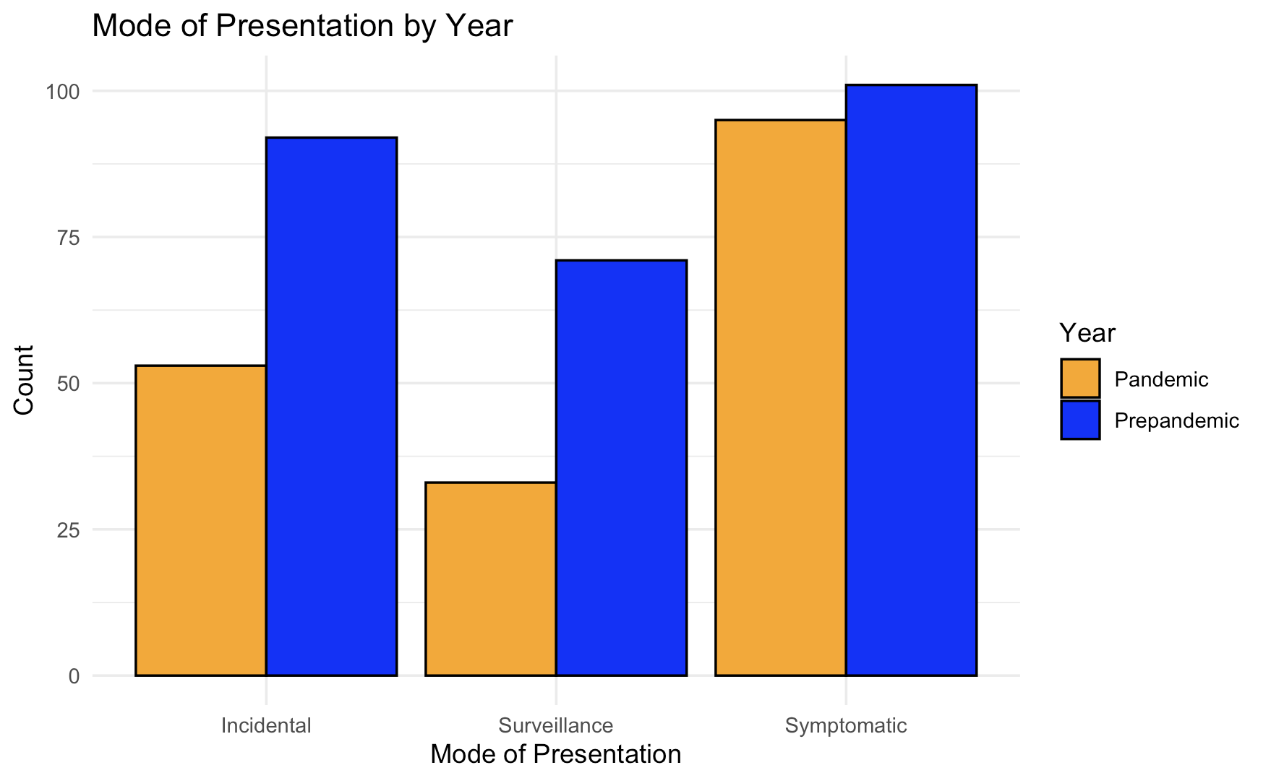
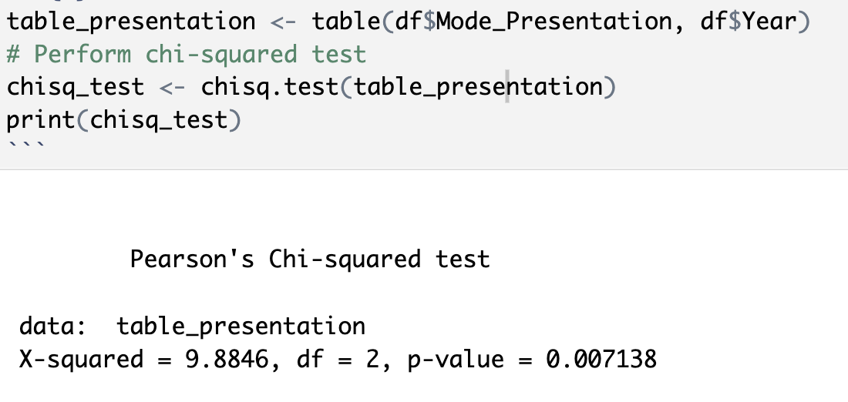
Did COVID-19 impact the way in which Liver Cancer was diagnosed?
A Pearson's chi-squared test was conducted to examine the association between the mode of presentation and the pandemic year status.
Null Hypothesis (Ho): The distribution of liver cancer diagnosis methods remains consistent between the pandemic and pre-pandemic periods.
Alternative Hypothesis (Ha): The distribution of liver cancer diagnosis methods differs between the pandemic and pre-pandemic periods.
The test results in p-value of 0.007 (<0.05) which indicates that there is sufficient evidence to reject the null hypothesis.Therefore, it is inferred that the distribution of liver cancer diagnosis methods significantly differs between the pandemic and pre-pandemic periods .Specifically, there was a notable decrease of around 50% in cases detected through incidental and surveillance methods during the pandemic period compared to the pre-pandemic period.

Slide 22
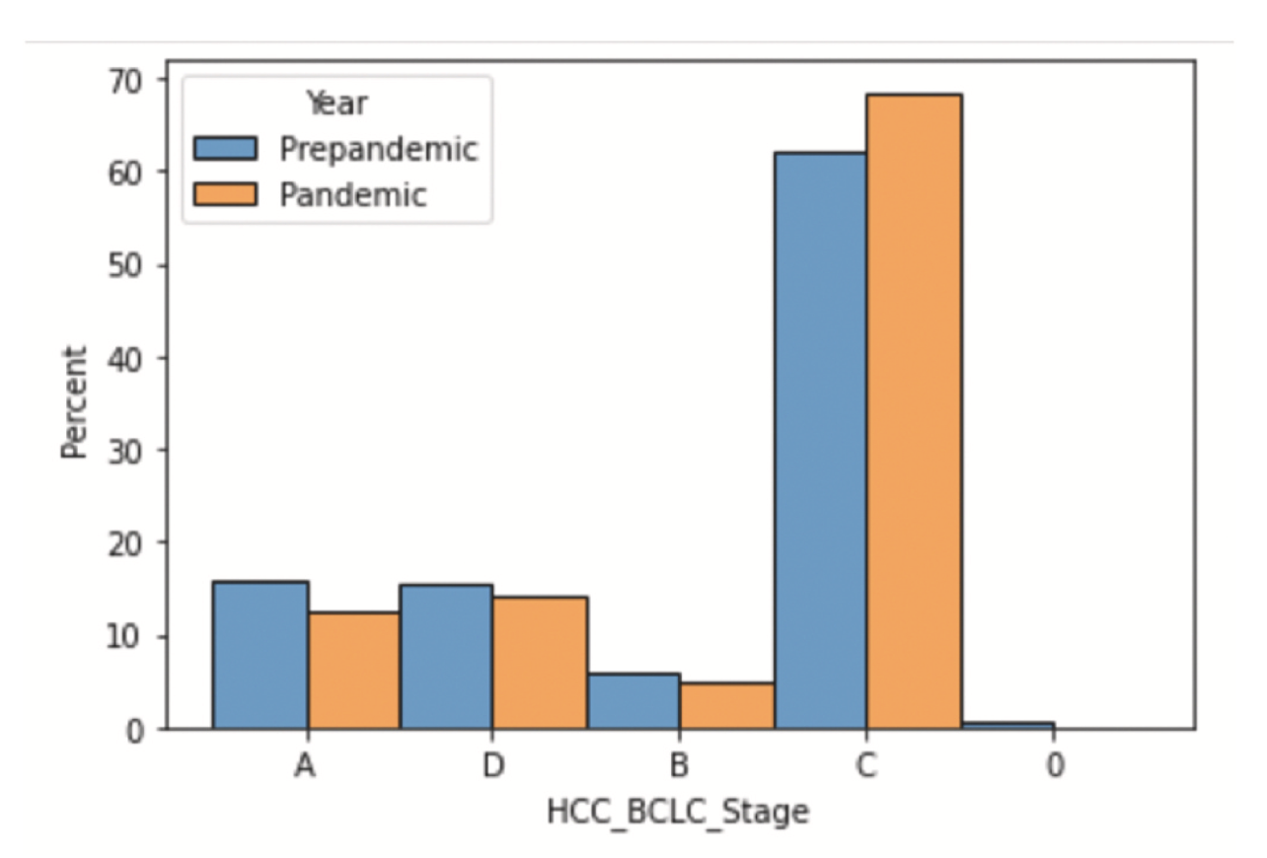
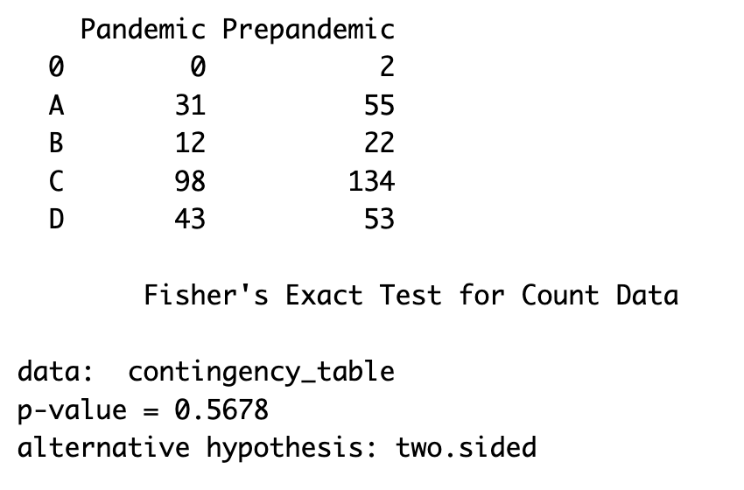
Did the COVID-19 pandemic impact the distribution of liver cancer diagnoses across different BCLC stages?
Modified Null Hypothesis (Ho): There is no significant difference in the distribution of liver cancer diagnoses across different BCLC stages between the pandemic and pre-pandemic periods.
Modified Alternative Hypothesis (Ha): There is a significant difference in the distribution of liver cancer diagnoses across different BCLC stages between the pandemic and pre-pandemic periods.
With a p-value of 0.5678 obtained from Fisher's Exact Test, we fail to reject the null hypothesis. Therefore, it does not appear that COVID-19 had a significant impact on the distribution of liver cancer diagnoses across BCLC stages.

Slide 23
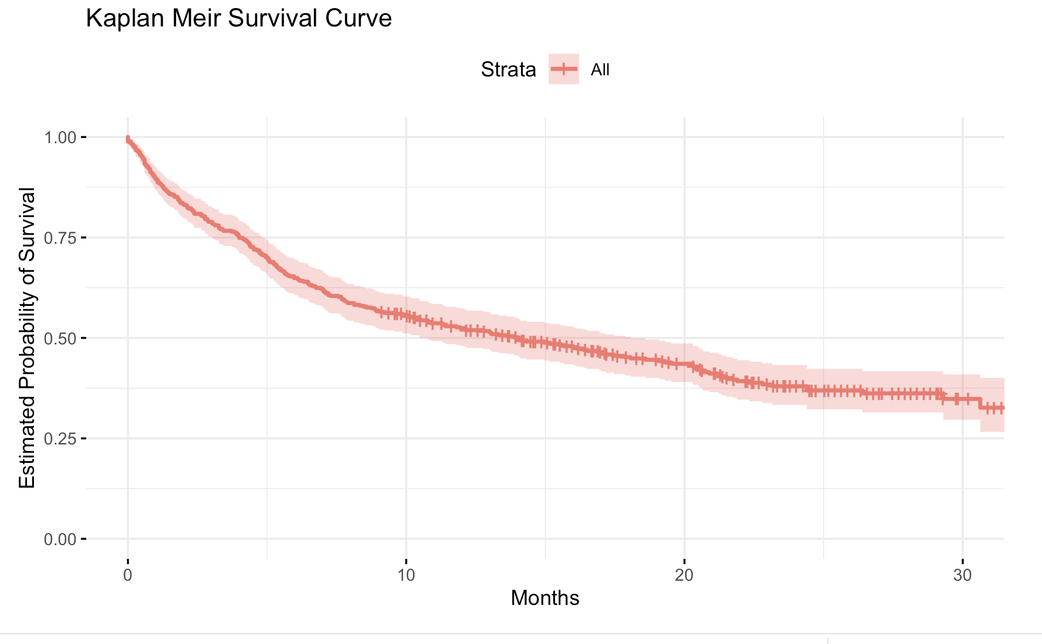
3.4 SURVIVAL ANALYSIS
The Kaplan-Meier survival curve illustrates the estimated probability of survival over time for patients in this study.
This visualization provides valuable insights into the overall survival trends among the patients under study.

Slide 24
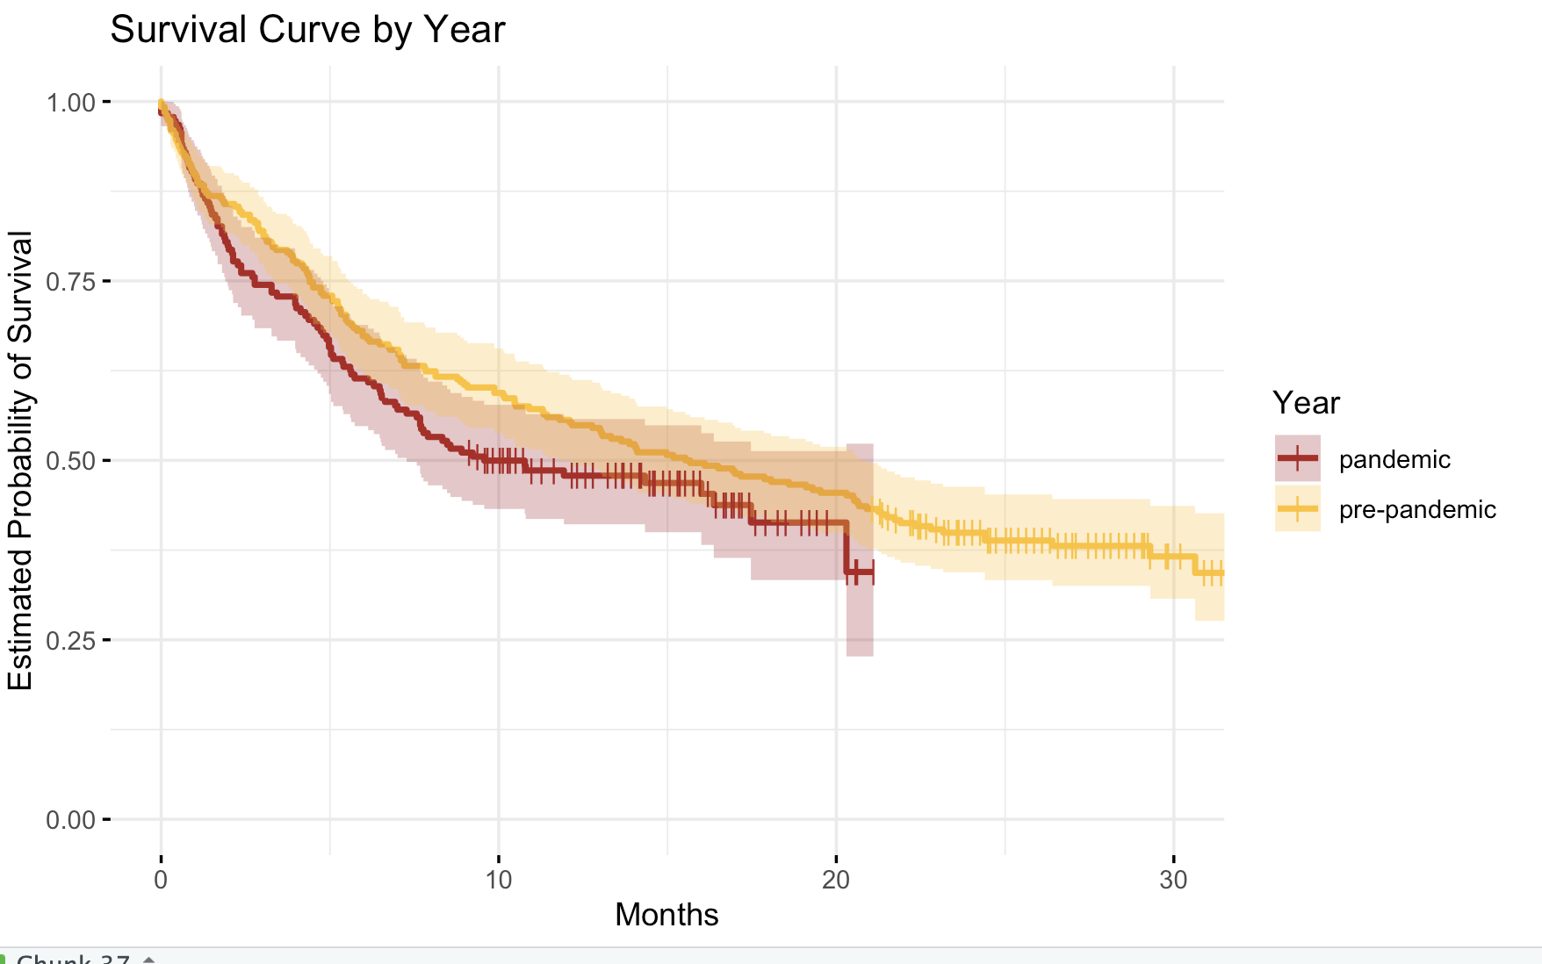
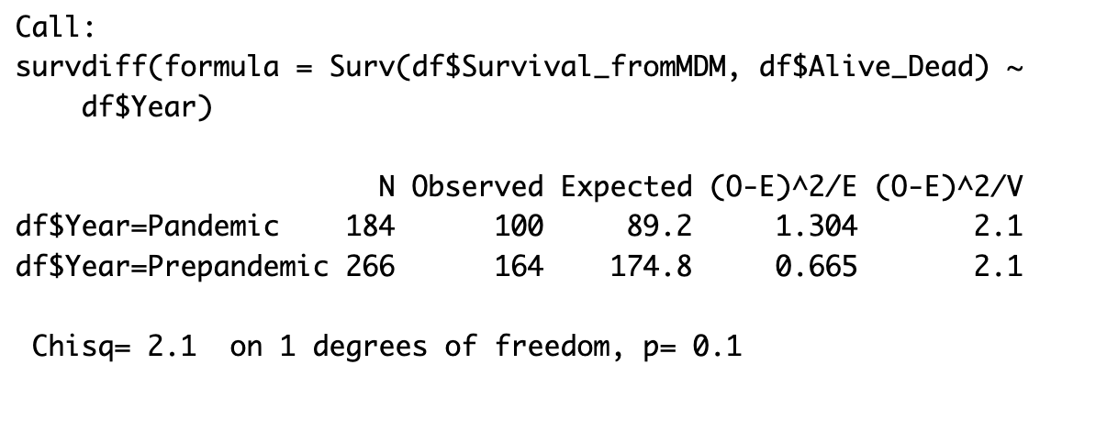
Comparing Survival Rates of Liver Cancer Patients:
Pre-Pandemic vs. Pandemic
We compared the survival curves of patients diagnosed during the pandemic and pre-pandemic periods.
From the plot, it's evident that the group diagnosed before the pandemic had a better chance of surviving than the group diagnosed during the pandemic period.
The log-rank test yields a p-value of 0.1, we fail to reject the null hypothesis, indicating that the pandemic may not have had a significant impact on the overall survival of patients diagnosed with liver cancer.

Slide 25
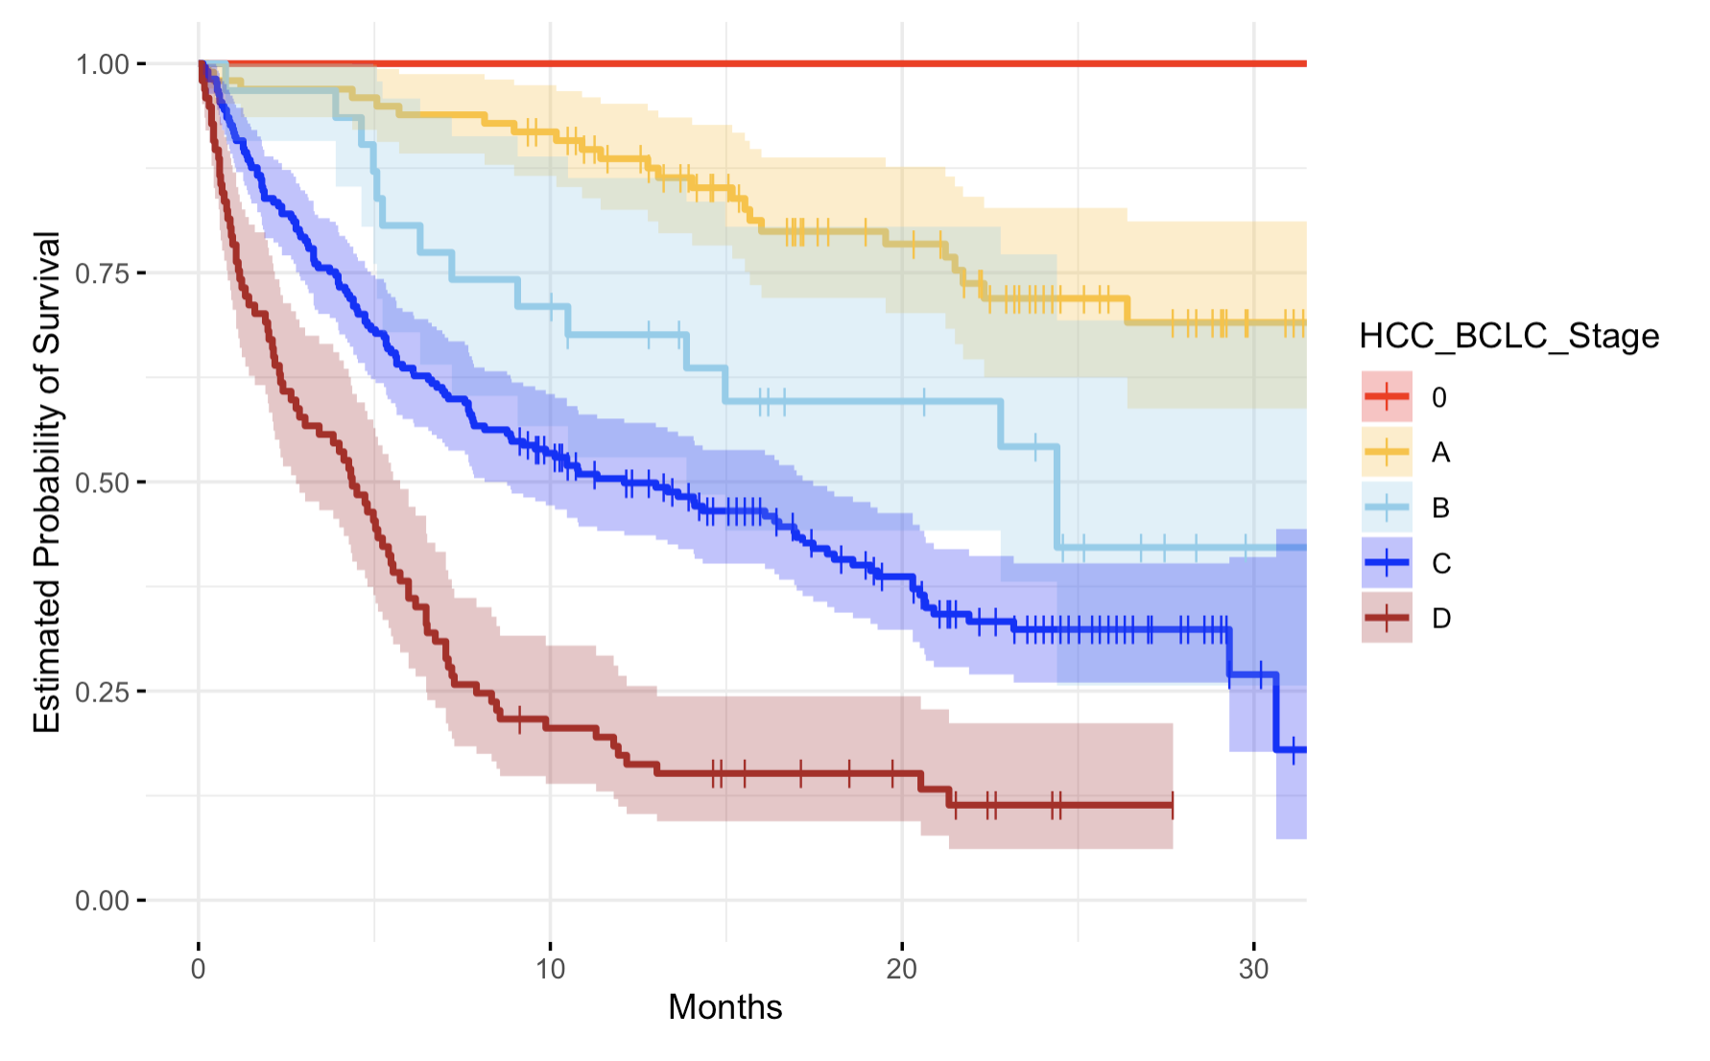
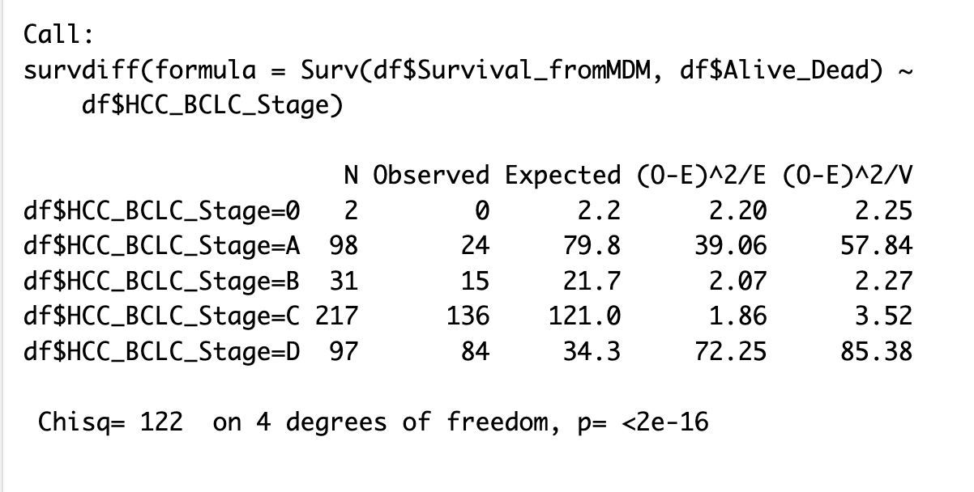
2. Across Barcelona Clinic Liver Cancer (BCLC) Stage
We plotted survival curves depicting the estimated probability of survival among liver cancer patients across different Barcelona Clinic Liver Cancer (BCLC) stages.
The survival curves progressively decline as the BCLC stage advances, indicating a poorer prognosis for patients with more advanced liver cancer stages. This information can be crucial for clinicians in predicting patient outcomes and guiding treatment decisions for liver cancer patients.
The log-rank test results indicate a highly significant difference in survival rates across the BCLC stages (p < 2e-16), suggesting that the stage of liver cancer significantly affects patient survival.

Slide 26
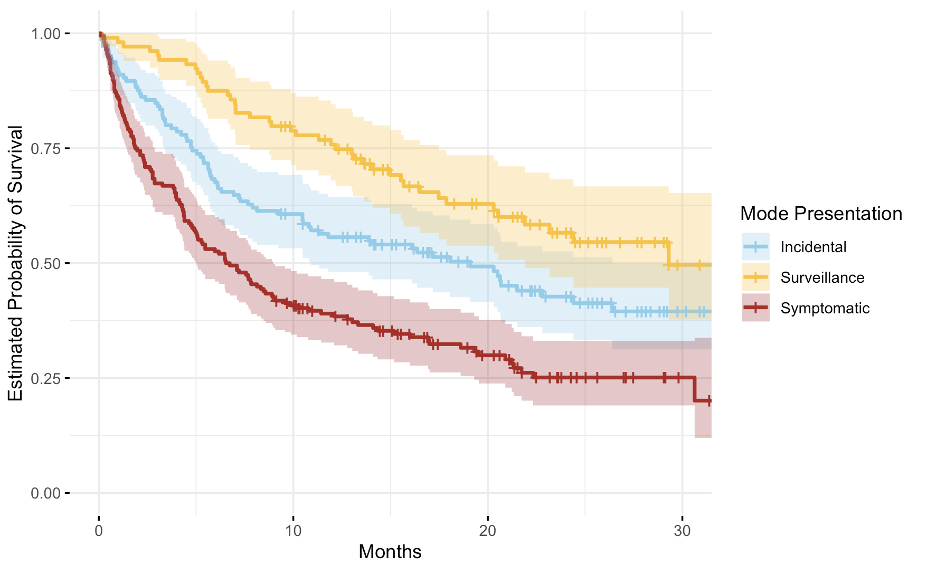
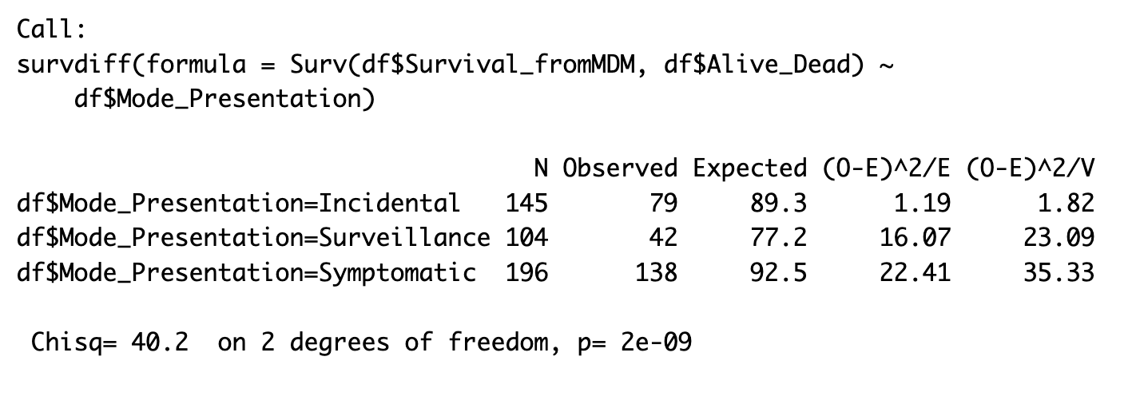
3. Across the manner in which cancer was detected (Mode of Presentation)
We compared survival curves of liver cancer patients stratified across different modes of presentation.
The survival curves show distinct patterns based on the mode of presentation, with Surveillance-diagnosed patients exhibiting the highest survival probability over time, followed by Incidental and Symptomatic groups. This indicates that the mode of presentation significantly impacts the survival probability of liver cancer patients.
The log-rank test results reveal a highly significant difference in survival rates across different modes of presentation (p = 2e-09), underscoring the importance of early detection through surveillance in improving treatment outcomes and extending survival times for liver cancer patients.

Slide 27
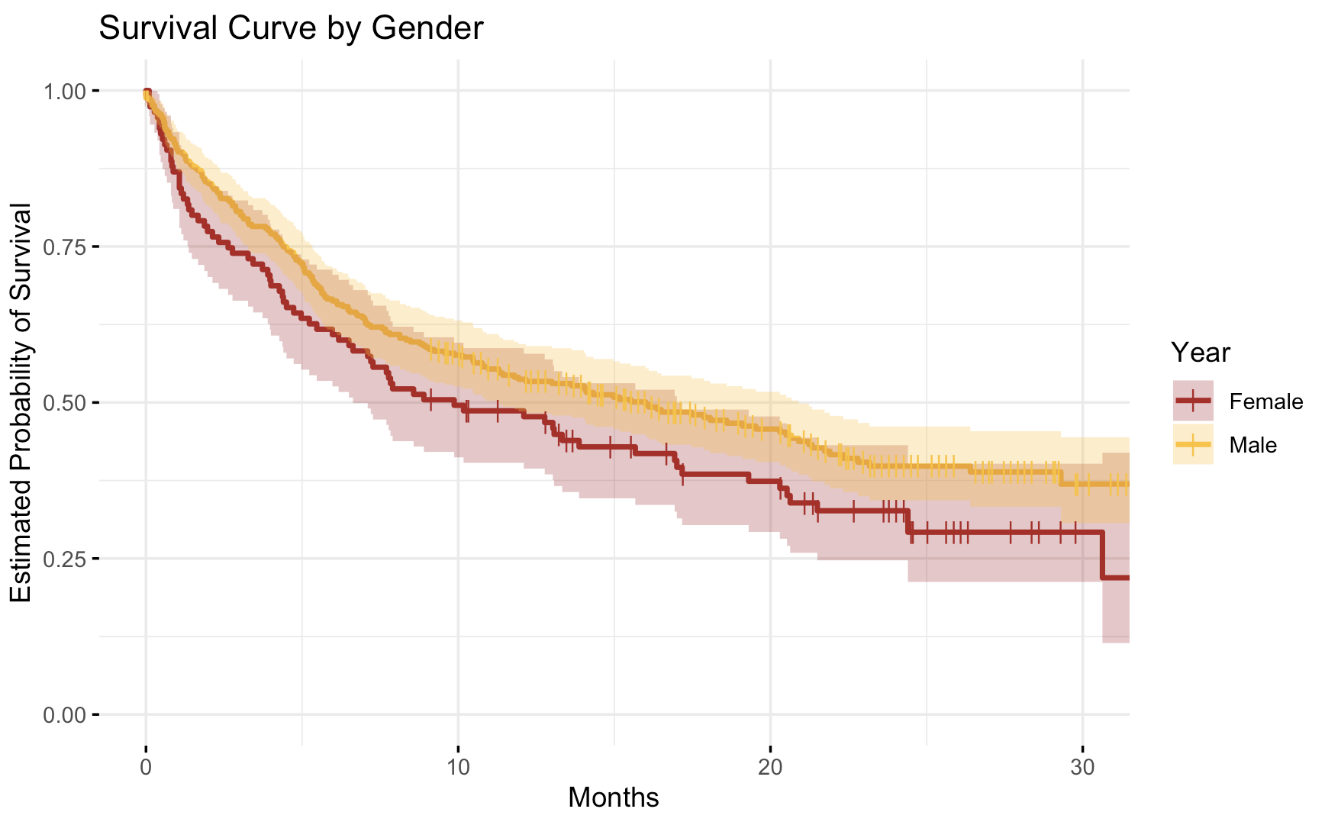
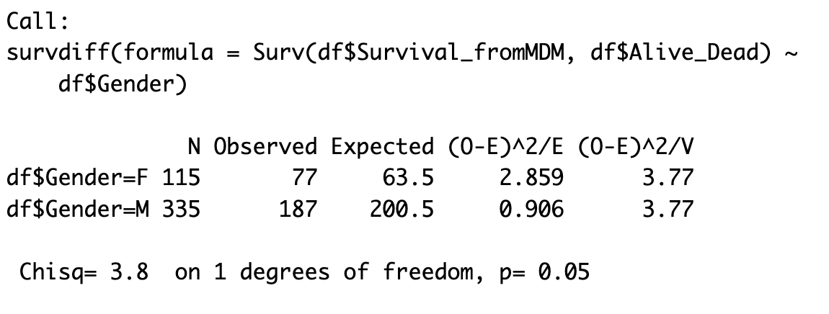
4. Across Gender
We compared the survival curves of Male and Female patients.
The survival curve for males shows a slightly higher estimated probability of survival compared to females over time.
The log-rank test indicates a statistically significant difference in survival rates between genders (p = 0.05). This suggests that gender may play a role in determining survival outcomes for liver cancer patients, with males having a better prognosis compared to females.
Gender

Slide 28
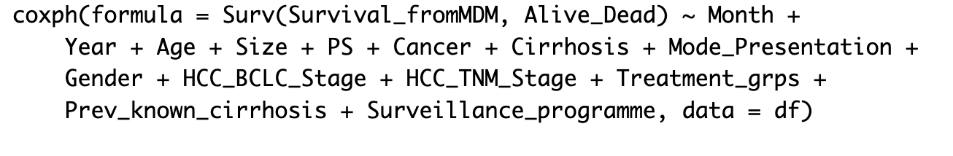
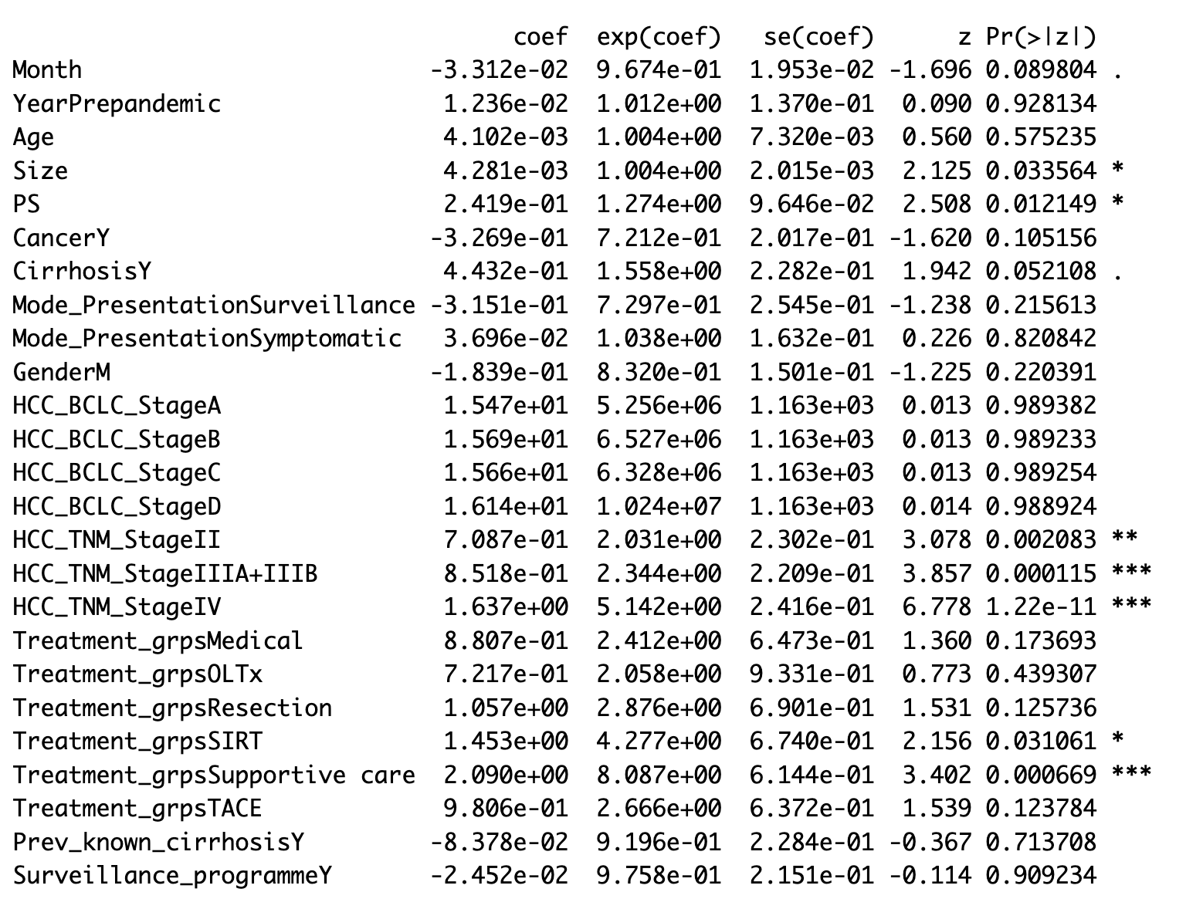
COX’S PROPORTIONAL HAZARDS MODEL
The Cox proportional hazards model was applied to assess the association between various factors and survival outcomes among liver cancer patients.
The hazard ratio (exp(coef))for each variable indicates the change in the risk of death associated with a one-unit change in the predictor, adjusting for other variables.
Inferences:
Larger tumor size is associated with a higher hazard of mortality (p = 0.033564), with a 0.4281% increase in hazard for each unit increase in tumor size.
Higher performance status is associated with a higher hazard of mortality (p = 0.012149), indicating that patients with poorer performance status have a higher risk of mortality.
Both BCLC and TNM stages significantly affect the hazard of mortality (all p < 0.05), indicating that patients with advanced cancer stages have a higher risk of mortality compared to earlier stages
The type of treatment significantly affects the hazard of mortality (all p < 0.05), with supportive care showing the highest hazard followed by SIRT, TNM Stage IV, and TACE.
In conclusion, while factors such as tumor size, performance status, cancer stage, and treatment type significantly influence the risk of mortality among liver cancer patients, other covariates in the model do not contribute significantly to the hazard of mortality.

Slide 29
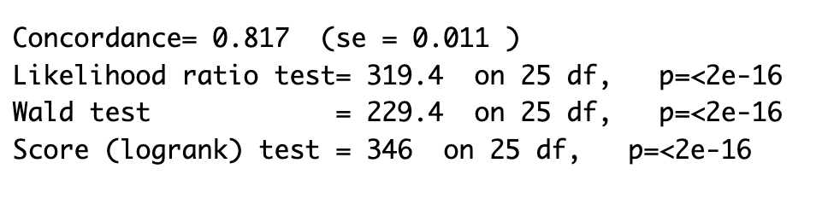
The C-index, or Concordance Index, serves as a metric for evaluating the predictive accuracy of our survival model for liver cancer patients.
It quantifies the model's ability to correctly rank patients based on their predicted survival probabilities.
The high C-index value (0.817) suggests that our survival model demonstrates a strong ability to discriminate between patients with different survival outcomes.
A C-index of 0.817 means that, for any randomly selected pair of patients, the model correctly predicts which patient will survive longer approximately 81.7% of the time.
Clinicians can rely on this model to make informed decisions regarding treatment strategies and patient management based on individualized risk assessments.

Slide 30
4. DISCUSSION
Our study aimed to assess the impact of the COVID-19 pandemic on liver cancer patients.
Impact of COVID-19 Pandemic on Cancer Detection:
A significant decrease in liver cancer cases detected during the pandemic period (~30% decline compared to non-pandemic periods) suggests disruptions in routine cancer screenings and medical appointments.
Potential delays in tumor detection and diagnosis, indicated by larger average tumor size during the pandemic, may result from overwhelmed healthcare facilities and reduced access to timely medical care.
Gender Disparities in Cancer Detection:
Significant differences in cancer case proportions between genders during the pandemic period, with males exhibiting a notably higher proportion of cases compared to females.
Cultural factors, such as higher alcohol consumption among men and potential increases in alcohol intake during the pandemic, may contribute to the observed gender disparities in cancer detection.

Slide 31
Survival Outcomes and Treatment Implications:
Progressive decline in survival probabilities as the Barcelona Clinic Liver Cancer (BCLC) stage advances underscores the importance of stage-specific interventions and personalized treatment approaches.
Significant differences in survival rates across different modes of presentation highlight the critical role of early detection through surveillance in improving treatment outcomes and extending survival times for liver cancer patients.
Implications for Clinical Practice and Future Directions:
Integration of comprehensive surveillance strategies and personalized treatment approaches based on predictive models, such as the Cox proportional hazards model, can mitigate the adverse effects of the pandemic and improve overall patient outcomes in the management of liver cancer.
Future research efforts should focus on addressing barriers to cancer detection and diagnosis, exploring gender-based disparities in prognosis, and implementing interventions to enhance access to timely medical care for liver cancer patients.

Slide 32
LITERATURE CITED
Fu Y, Liao H, Lv L. A Comparative Study of Various Methods for Handling Missing Data in UNSODA. Agriculture. 2021; 11(8):727. https://doi.org/10.3390/agriculture11080727
Islam, J. Y., Vidot, D. C., & Camacho-Rivera, M. (2021). Evaluating Mental Health–Related Symptoms Among Cancer Survivors During the COVID-19 Pandemic: An Analysis of the COVID Impact Survey. JCO Oncology Practice, OP.20.00752. https://doi.org/10.1200/op.20.00752
Geh, D., Watson, R., Sen, G., French, J. J., Hammond, J., Turner, P., ... & Reeves, H. L. (2022). COVID-19 and liver canxcer: lost patients and larger tumours. BMJ open gastroenterology, 9(1), e000794.
‌Ribaldone, D. G., Caviglia, G. P., Gaia, S., Rolle, E., Risso, A., Campion, D., Brunocilla, P. R., Saracco, G. M., & Carucci, P. (2022). Effect of COVID-19 Pandemic on Hepatocellular Carcinoma Diagnosis: Results from a Tertiary Care Center in North-West Italy. Current oncology (Toronto, Ont.), 29(3), 1422–1429. https://doi.org/10.3390/curroncol29030119

Slide 33
ACKNOWLEDGEMENTS
We would like to express our heartfelt gratitude to Professor Jack Mardekian for his continuous support and valuable guidance throughout this project. Professor Mardekian's expertise and responsiveness to our queries, even through email, have greatly influenced our understanding and approach to the project.

Slide 34
CHATGPT USAGE
Here's how we leveraged ChatGPT throughout the project:
ChatGPT assisted us in comprehending various hypothesis testing methodologies by providing clear explanations and examples.It helped us grasp the underlying concepts and apply them effectively to our data analysis.
When interpreting the outcomes of hypothesis tests, ChatGPT helped verify our interpretations and suggest alternative perspectives.
We utilized ChatGPT to refine and rephrase our research findings, making them more concise, coherent, and presentable.
We used it to debugging and correcting errors in our code. By providing suggestions and identifying potential pitfalls, it helped us troubleshoot issues promptly

Slide 35
THANK YOU

